Slide 1
Final Year Project – Group 23 Digital Home System in IoT Environment Team Member Au Chi Chung 150533022 Kwok Yuk Lam 150032356 Li Kai Kwong 150321559 Yu Kwok Ho 150031347
Supervisior : Johnny Kwong Co-Maker : Jesse Shum

Slide 2

Problem Background
Home Accidents

Slide 3




Home Accidents
Slip in a dark environment - 32.2%
Fire disaster - 25.8%
Falling from heights - 20.3%
Misuse of drugs - 18.7%
Source : Department of Health - "2008 Accidental Injury Survey"

Slide 4
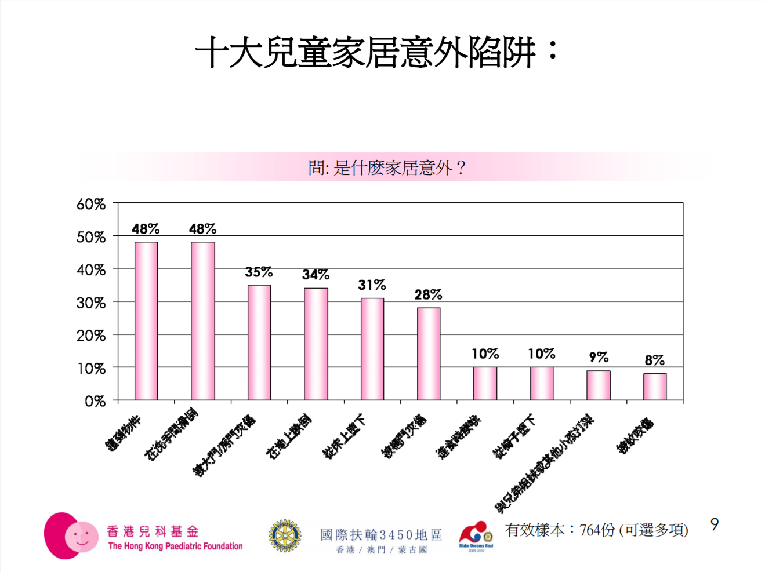
Home Accidents
Top 3 of children's home accident Bruised (48%) Slipping in the bathroom (48%) Pinched by doors or windows (35%)
Source : The Hong Kong Paediatric Foundation - "Hong Kong top 10 children home accident"

Slide 5

Problem Background
Flexible

Slide 6
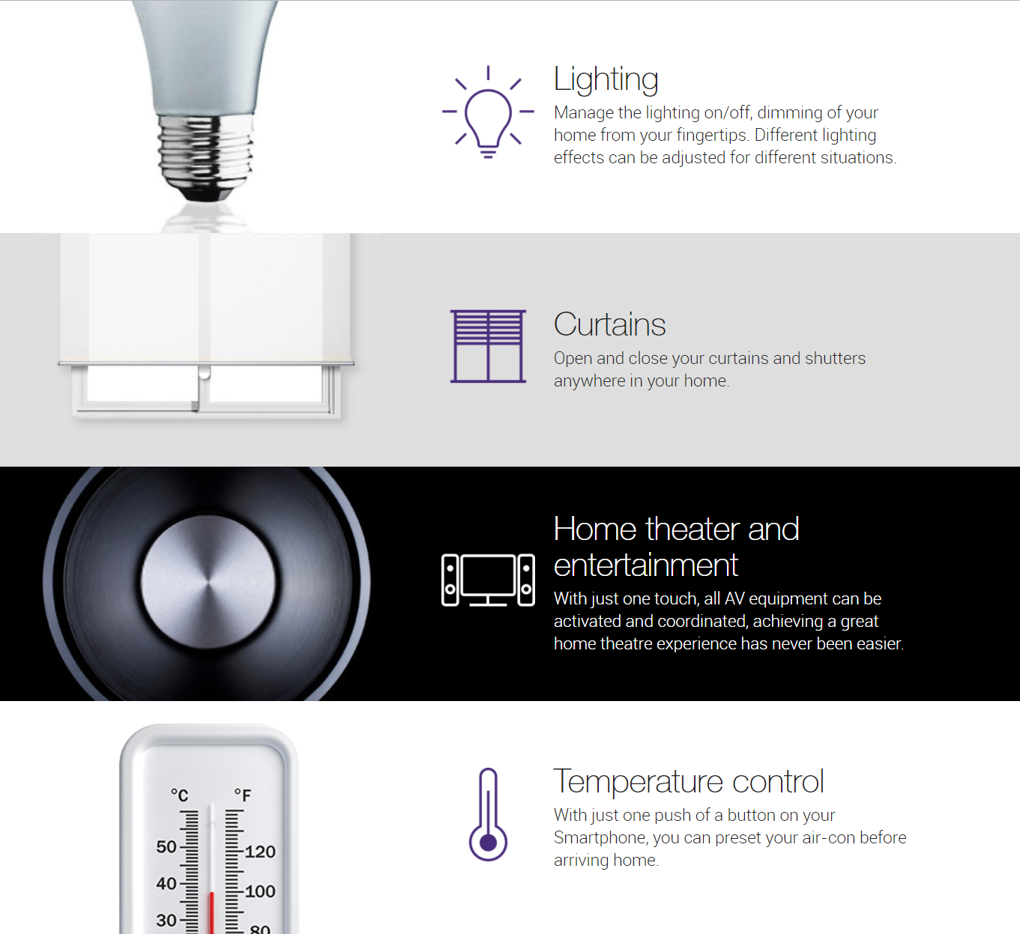
Flexible
Smart home system in market A fixed set of tool kit with the smart home controller. Use “Convenience" as the theme. Focus the target user on young peoples or office worker in middle class.
Source : PCCW HKT - "Smart Living"

Slide 7
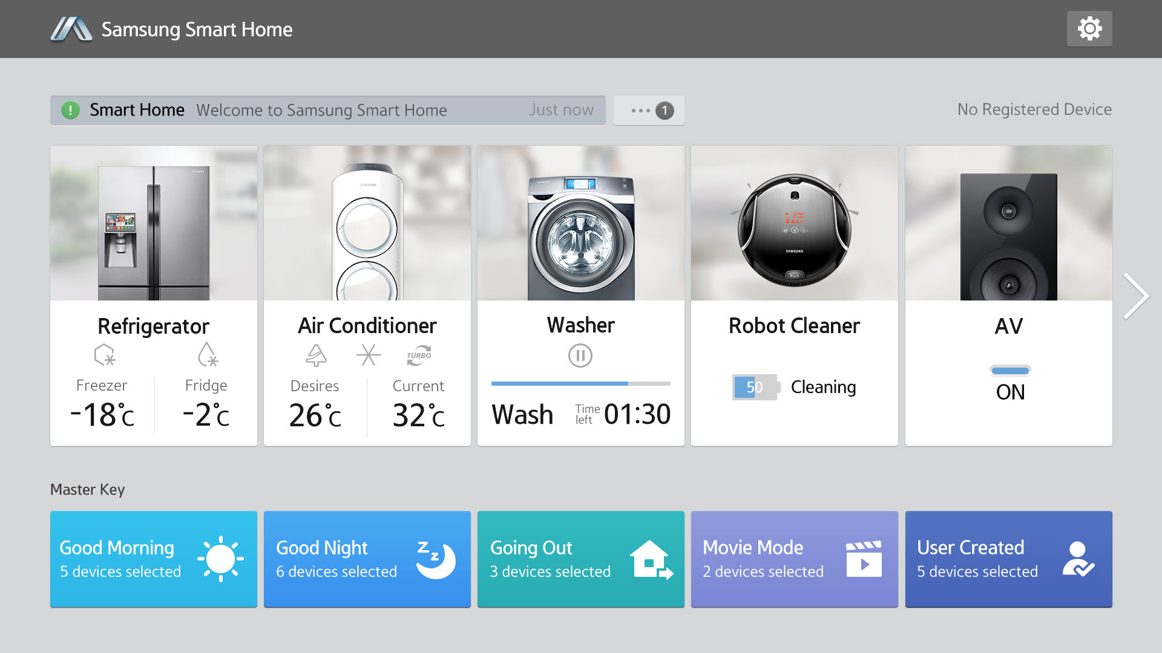
Example Case
Example Case It aims to the convenience for improving people’s lives. The device are fixed set that user can only use of the those device. No product focus on the issue of home safety.
Source : SAMSUNG - "Samsung Smart Home"

Slide 8
Project Objective

Slide 9
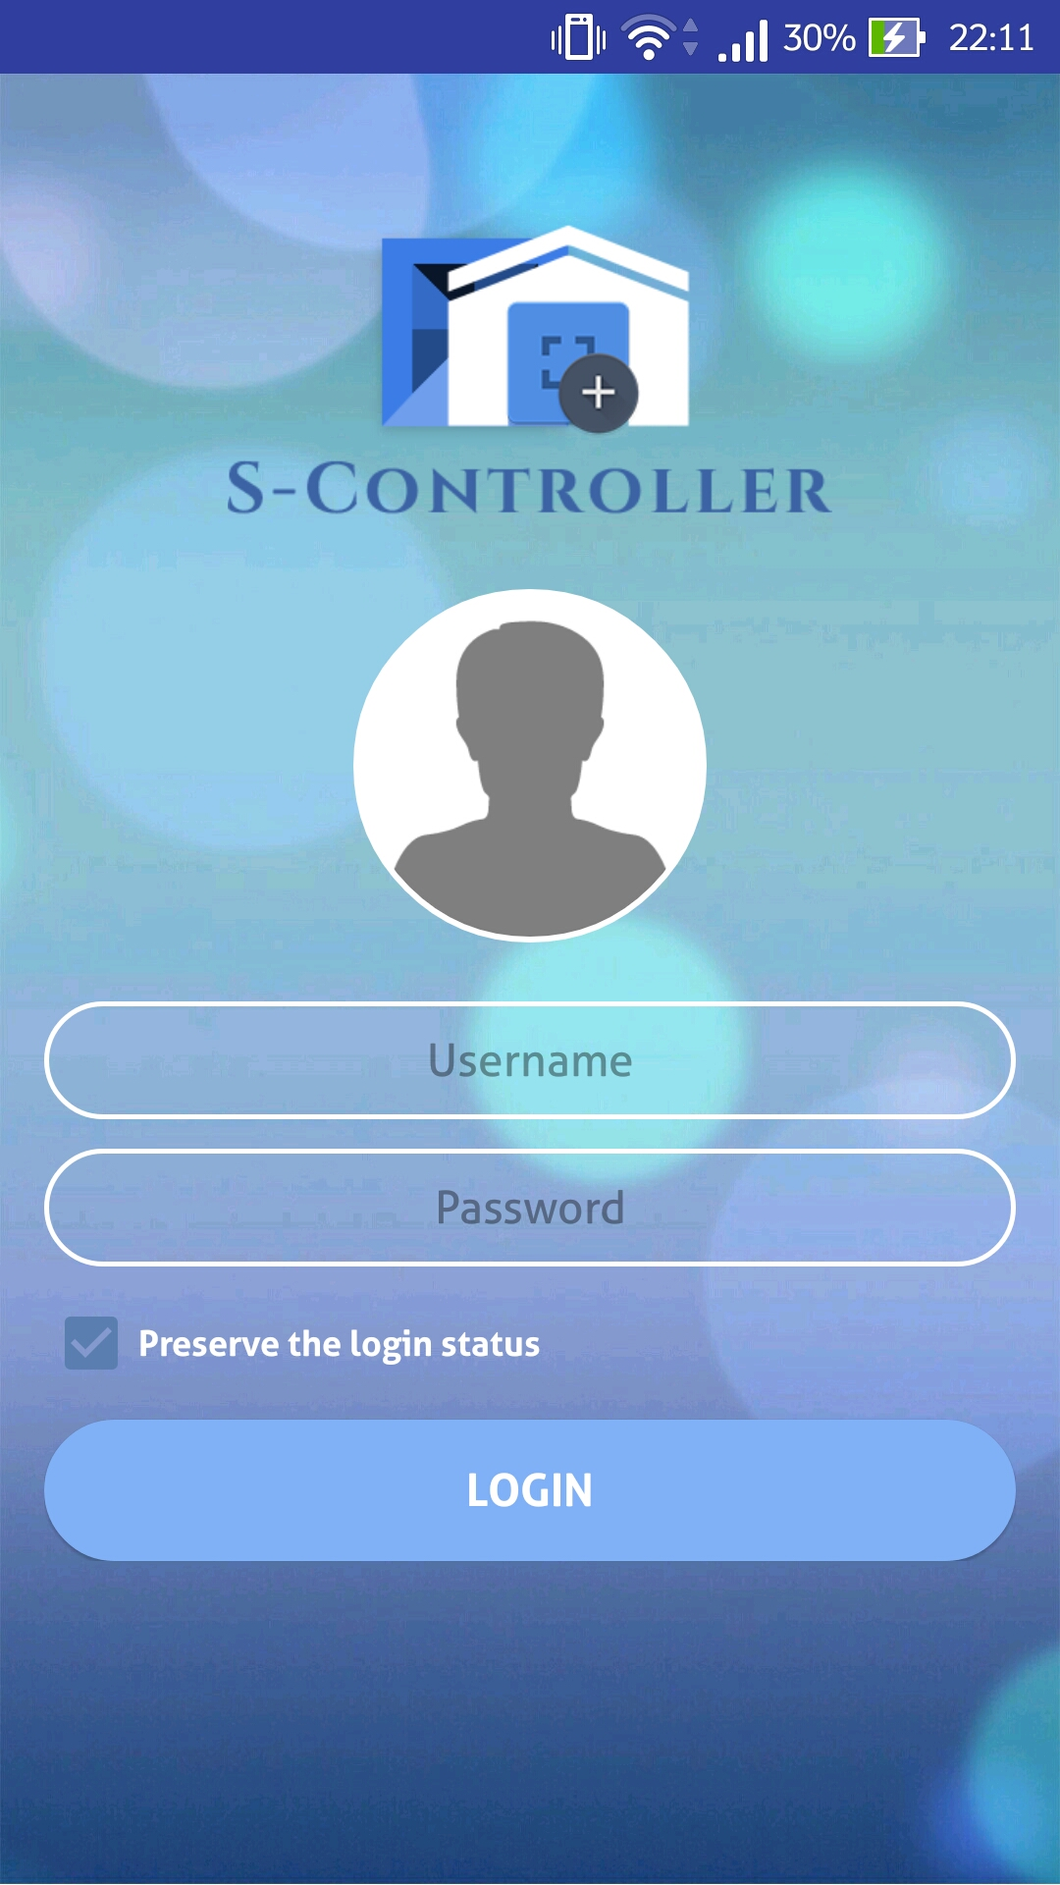
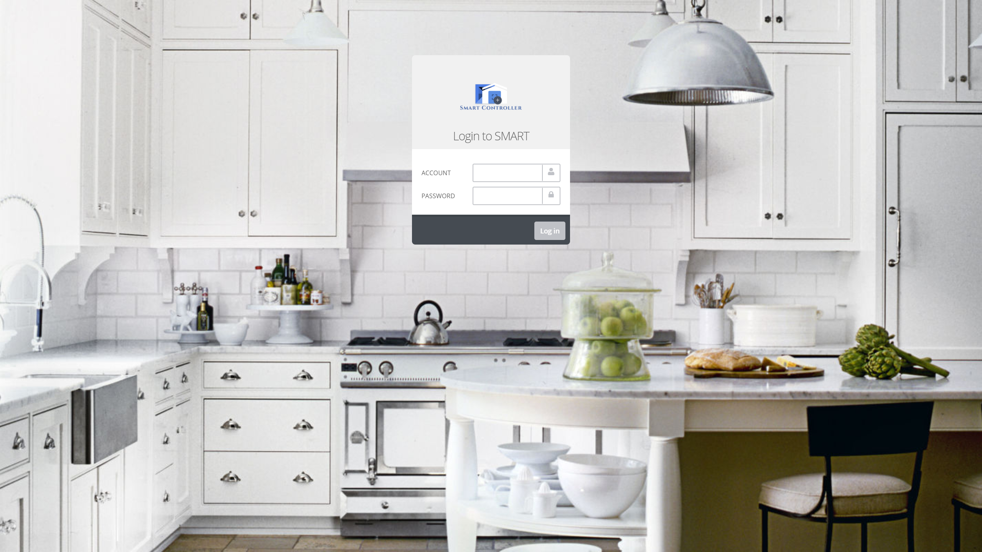

Project Objective
+
=

Slide 10
Project Objective
Able to direct or remote control the components.
Able to manage settings based on user preferences.
Focus on the details of home safety.
Focus the target user on
the family with elderly
and children.
Operating in different platform.

Slide 11
Main Functions

Slide 12
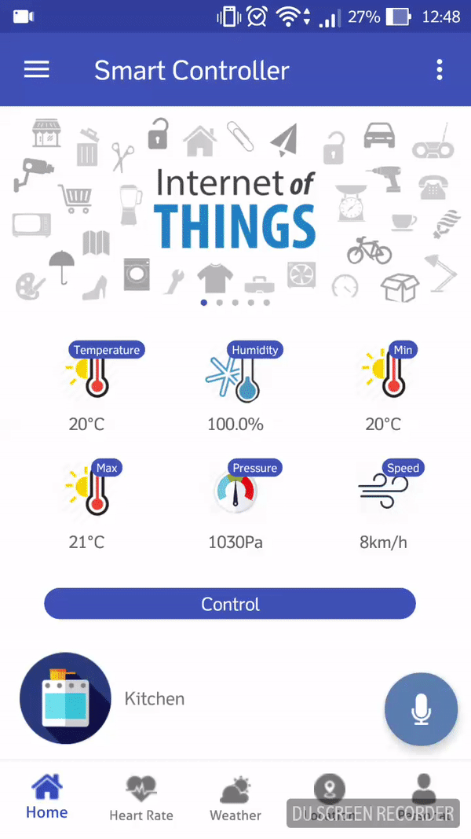
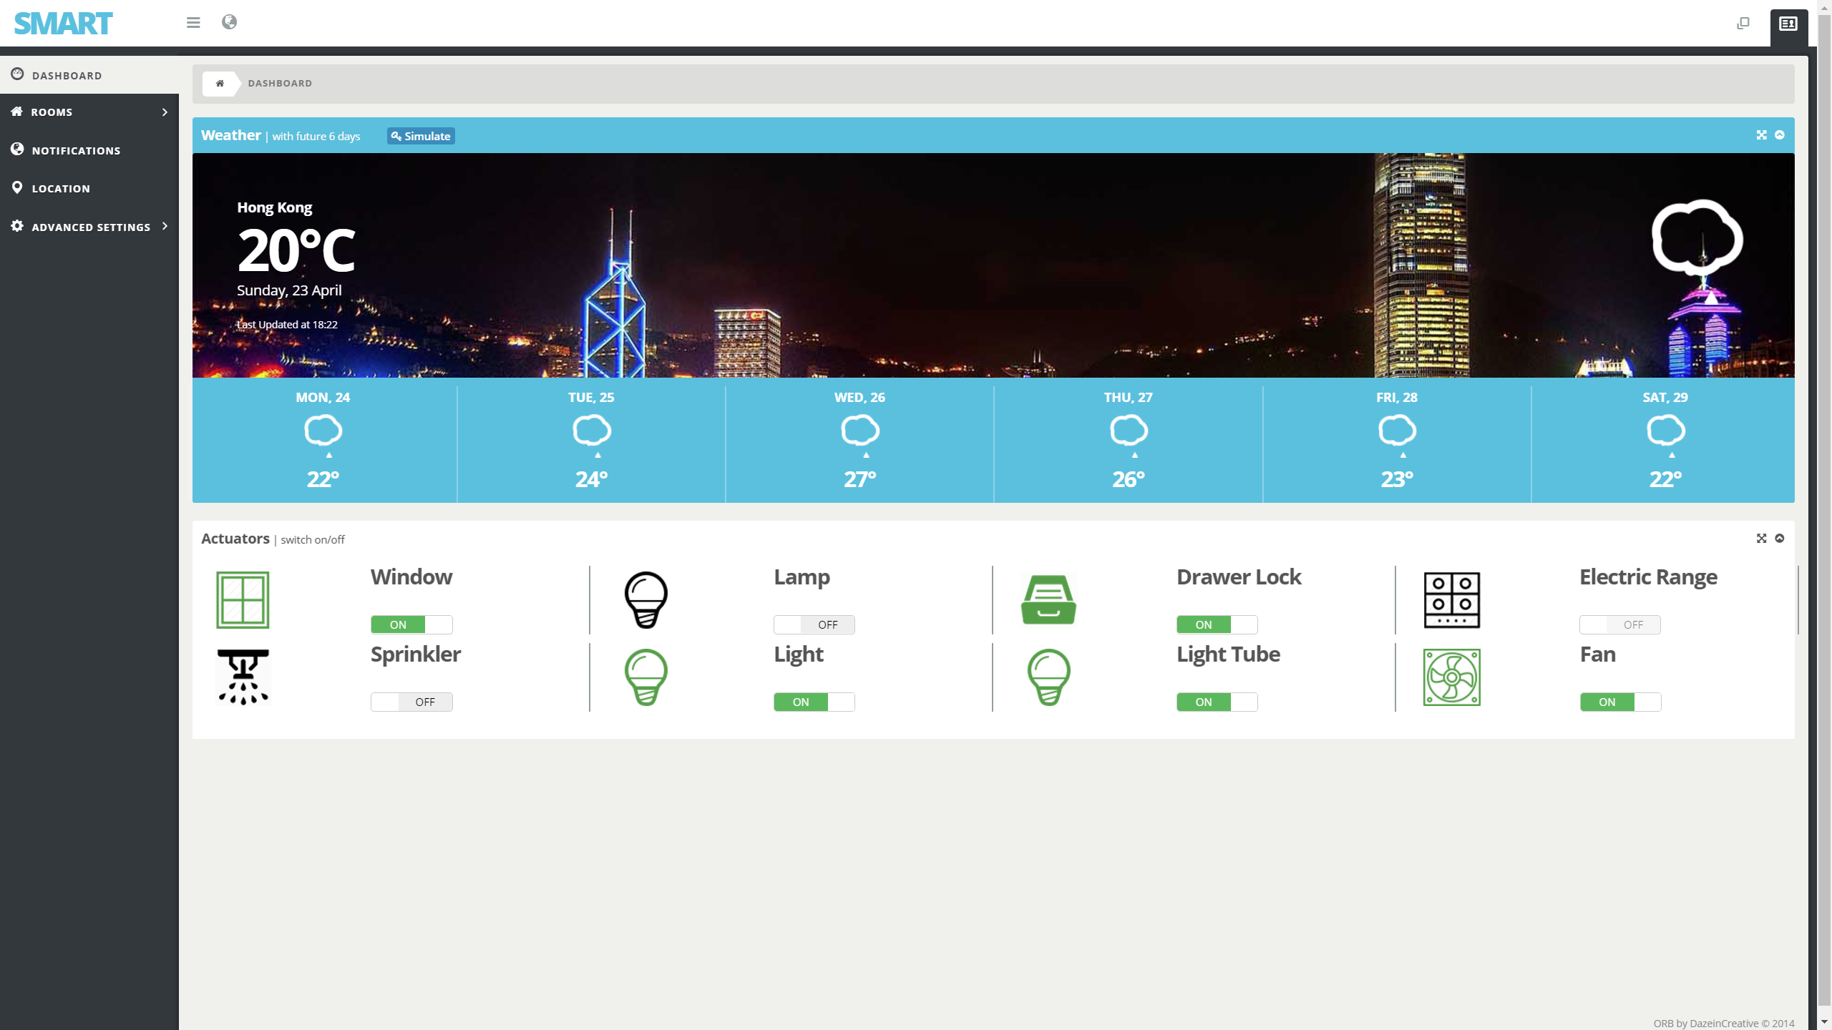
Main Functions
Controller

Slide 13
System Infrastructure

Slide 14
System Infrastructure
Major Components
Frontend
For Website and Android application Receive user action Display real-time system information to users Allow user setting the entire system
Server
Store data to database including user action ➔ Logical part such as performing some related actions according to the user settings stored in database

Slide 15
System Infrastructure
Raspberry PI
Raspberry PI is a home central controller, which connects different Sensors and Actuators Sensor is responsible for getting some values of the real environment ➔ Actuator, like furniture, performs action based on the message transferred by Pi Controller
Pusher
Pusher is a hosted service that makes the server easy to transfer some real-time data to different frontend.
PI Controller
Used to receive Pusher data Based on the data, ask the Pi to perform different actuators’ actions Same network with Raspberry PI

Slide 16
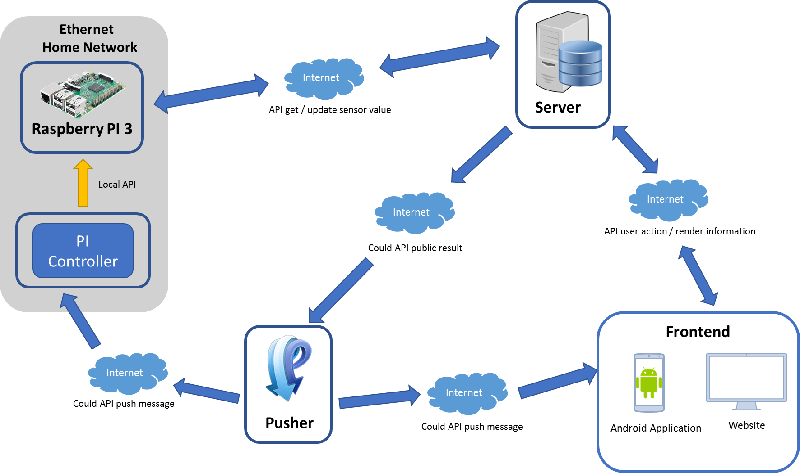
System Infrastructure
Relationship of Components

Slide 17
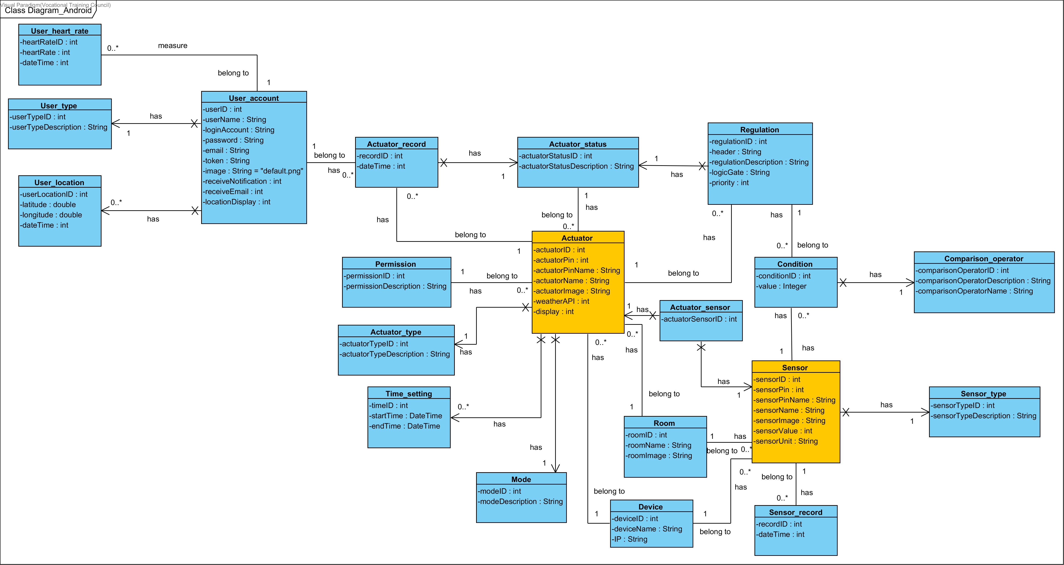
Class Diagram

Slide 18
Example Cases

Slide 19
Example Cases
Case 1
Aim : Reduce opportunity of slipping in the dark environment
Sensor : Motion
Detect movement
Turn on the light automatically

Slide 20
Example Cases
Case 2
Aim : Decrease the accident rate of falling from heights
Sensor : Rain
Detect rainwater
Close the window automatically

Slide 21
Example Cases
Case 3
Aim : Avoid fire spread when a fire disaster is happened
Sensor : Flame
Detect a fire in warning level
Turn off the electric range +
Open the sprinkler automatically +
Take a photo and send to users by email

Slide 22
Advanced Settings

Slide 23
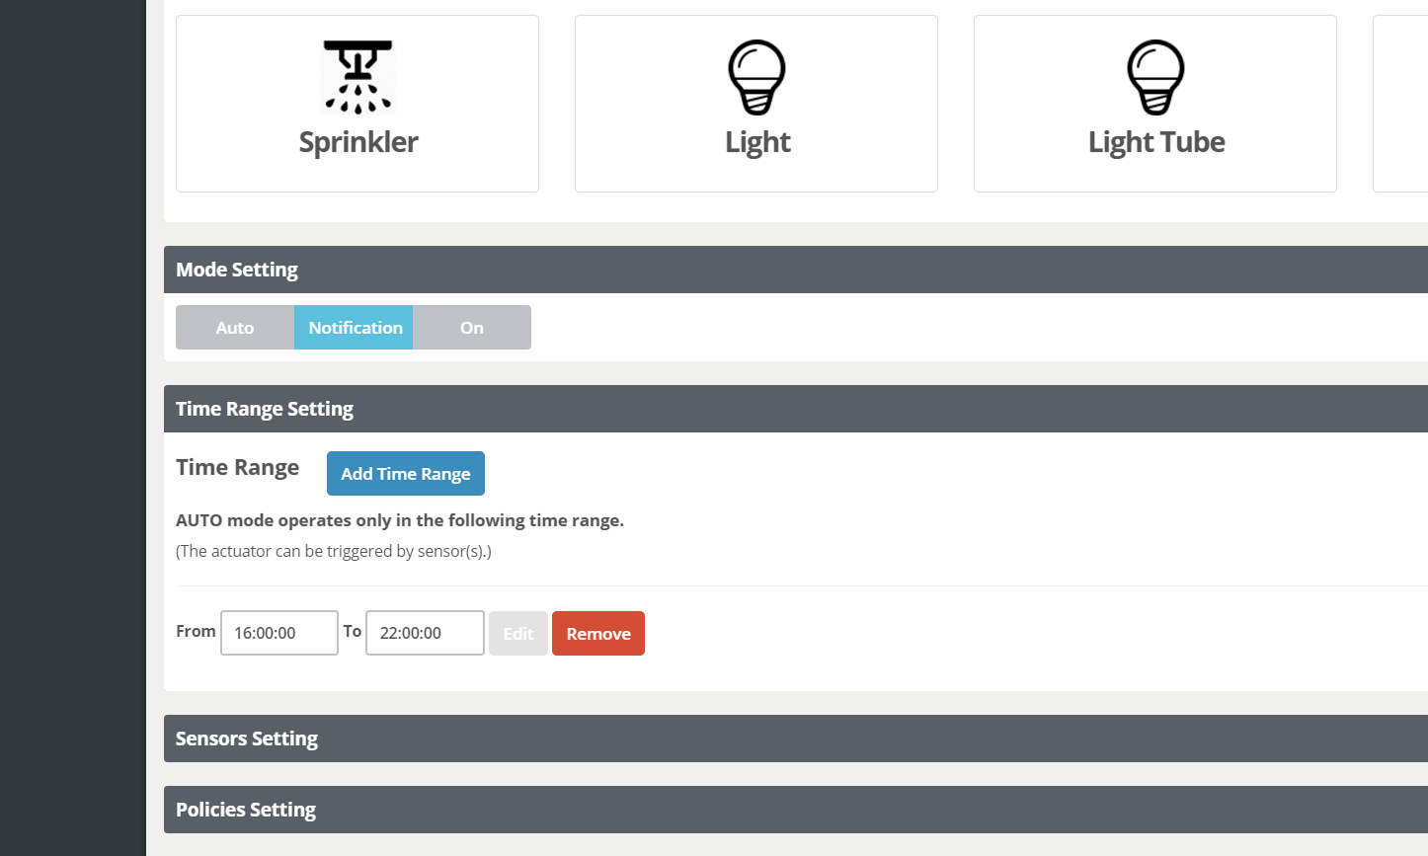
Advanced Settings
Actuator Settings
Mode
Time Range
Sensor
Policy

Slide 24
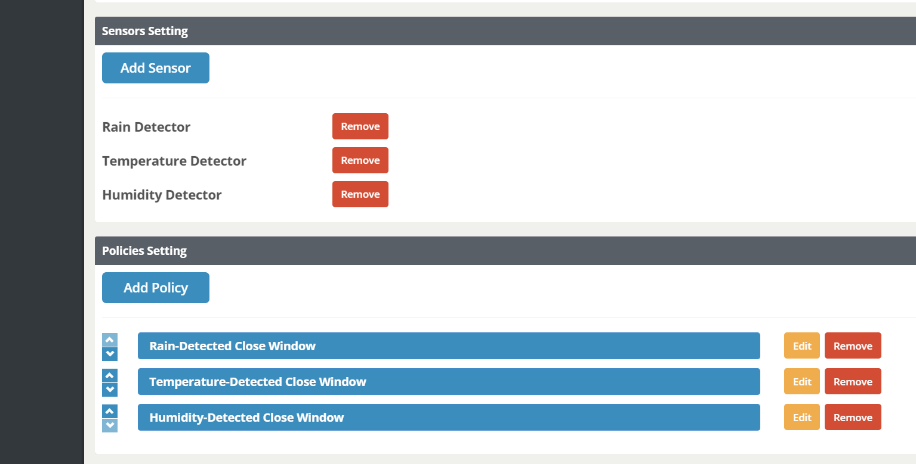
Advanced Settings
Actuator Settings
Mode
Time Range
Sensor
Policy

Slide 25
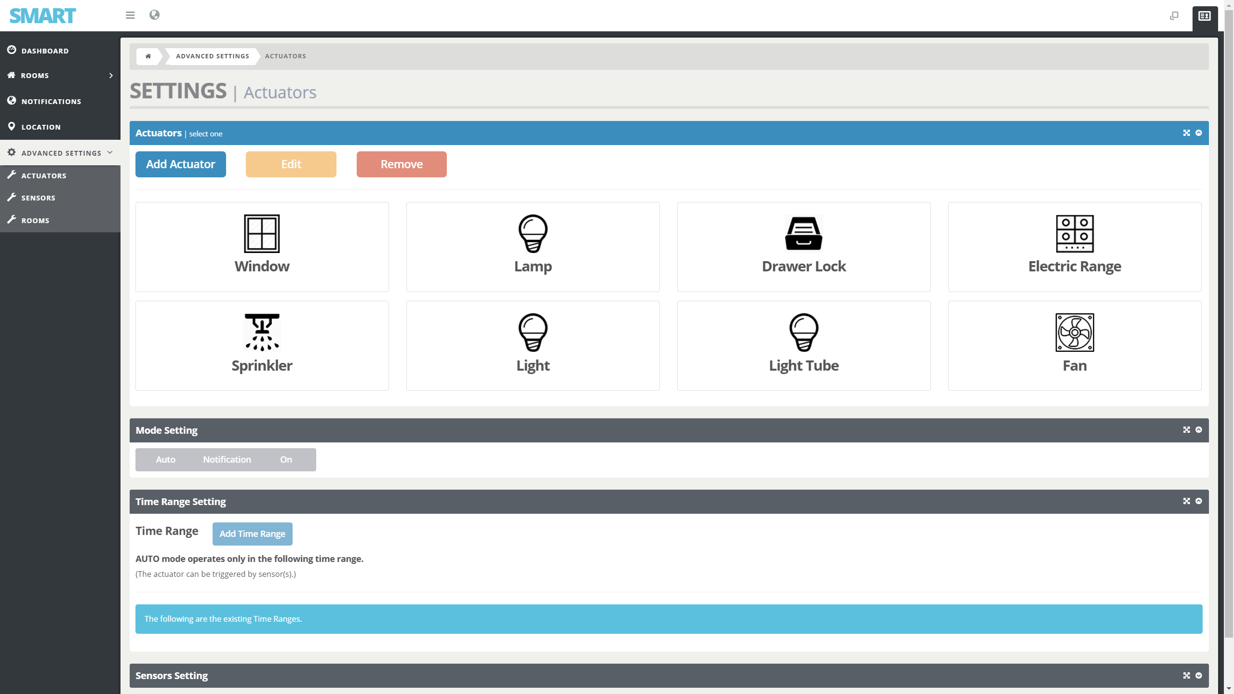
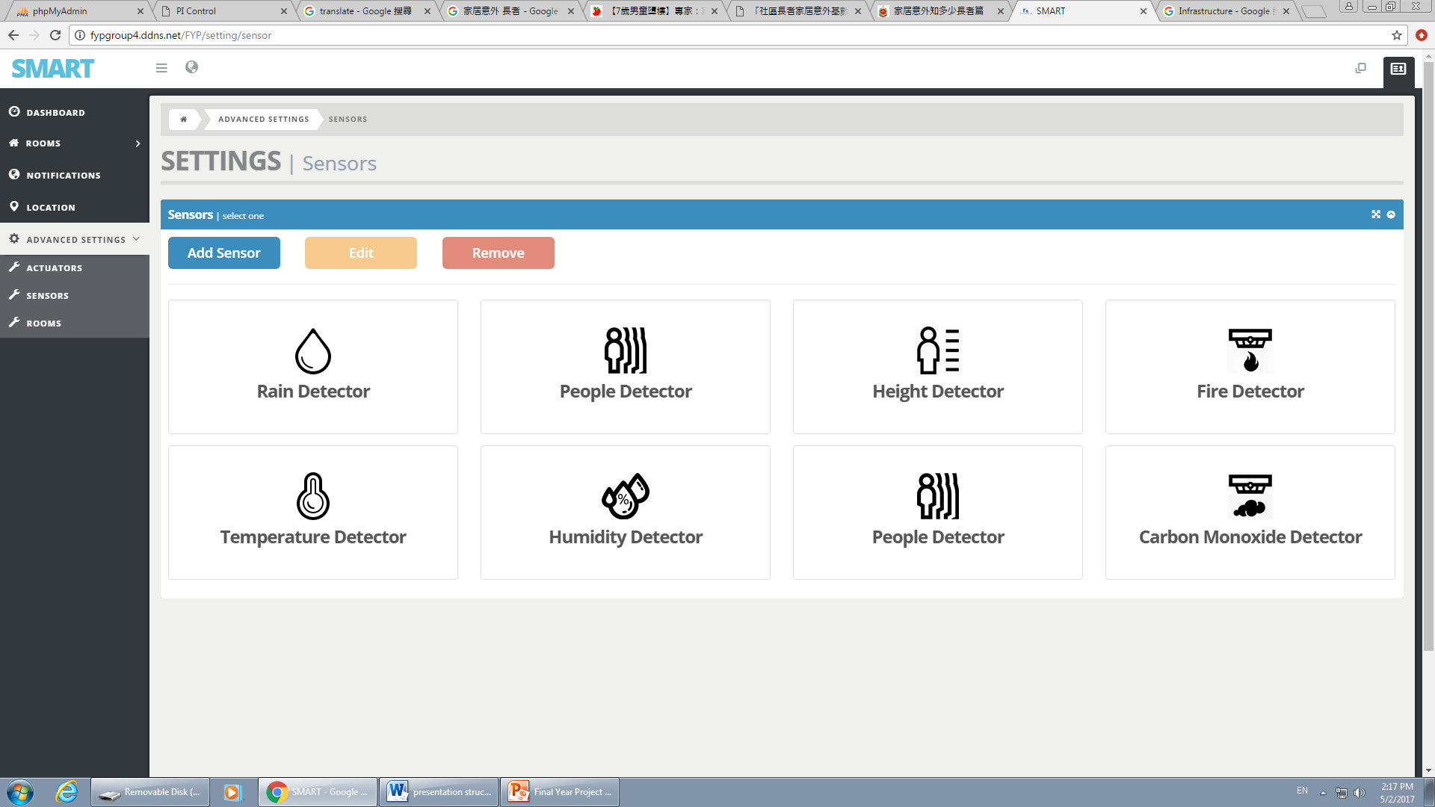
Advanced Settings
Actuator & Sensor Settings
Add
Edit
Remove

Slide 26
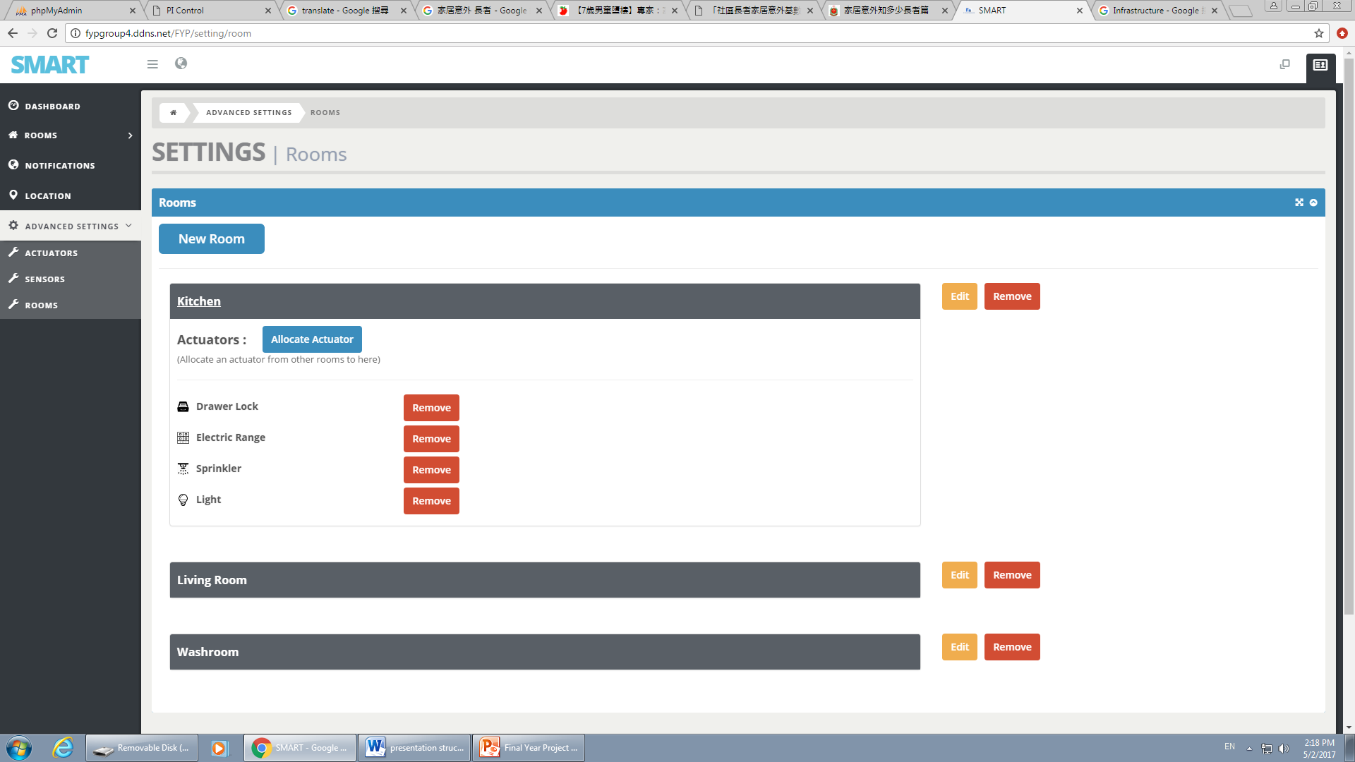
Advanced Settings
Room Settings
Add
Edit
Remove
Allocate Actuators

Slide 27
How to do ?

Slide 28
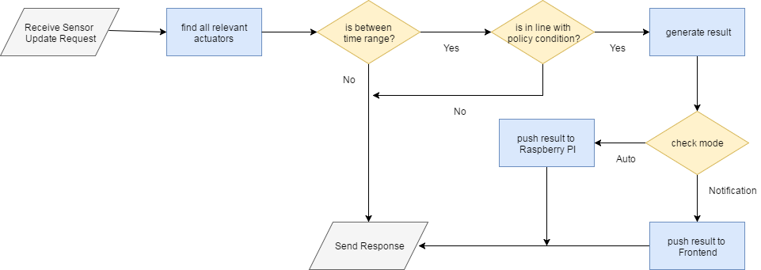
Flowchart
Server

Slide 29
Conclusion

Slide 30
Conclusion
Avoid the potential danger
of
home accidents
Automatic
processes
Combine sensors and actuators freely
Manage different policies based on user preferences

Slide 31
End of the Presentation
Ending

Slide 32
Project Planning

Slide 33
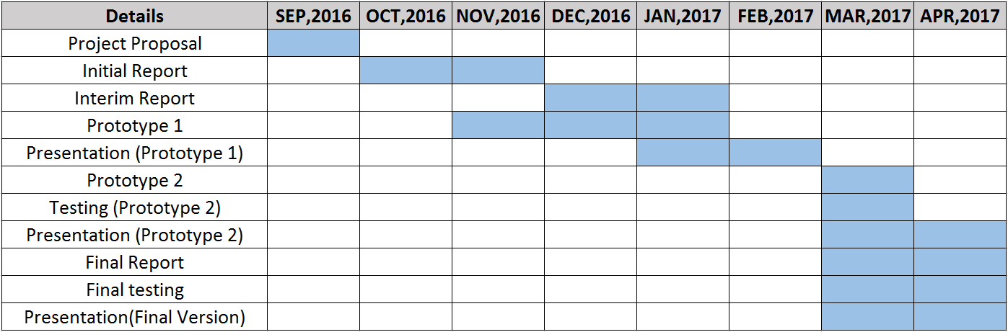
Project Schedules
Planning Phrase ( Deliverables : Project Proposal [27 / 9 / 2016] ) Analysis Phrase ( Deliverables : Initial Report [28 / 11 / 2016] ) Design Phrase ( Deliverables : Interim Report [16 / 01 / 2017] ) Implementation Phrase ( Deliverables : Final Report & Digital home system [19 / 04 / 2017] )

Slide 34
Testing Strategy
Test No. | Test | Description | Date
Android
T1 | Login | Enter different input | 11-3-2017
T2 | Control actuators | Control all actuators | 11-3-2017
T3 | Control actuators by sound | Control actuators to open or close by sound | 11-3-2017
T4 | Speech weather information | Click weather icon to speech by system | 11-3-2017
T5 | Measure heart rate and show history | Measure heart rate and show the heart rate records (including history) | 11-3-2017
T6 | Show weather information in detailed | Show weather information in detailed such as temperature, humidity and related charts | 18-3-2017
T7 | Show current location [and other users (for root accounts only)] | Show current location [and other users (for root accounts only)] | 18-3-2017
T8 | Show profile information | Show profile information such as name, account type and email | 18-3-2017
T9 | Change settings | Change users’ preferences | 18-3-2017
ANDROID

Slide 35
Testing Strategy
Test No. | Test | Description | Date
Web
T10 | Login | Enter different input | 11-3-2017
T11 | Control actuators | Control all actuators | 11-3-2017
T12 | Manage actuators | Manage actuators’ settings such as time range | 25-3-2017
T13 | Push and receive notification | Push and receive notification for each actuator in Notification mode | 25-3-2017
T14 | Manage notification | Manage notification (filter) | 25-3-2017
T15 | Show current location [and other users (for root accounts only)] | Show current location [and other users (for root accounts only)] | 25-3-2017
T16 | Show profile information | Show profile information such as name, account id and other members | 1-4-2017
T17 | Manage users (for root accounts only) | Manage users such as adding, editing and deleting user | 1-4-2017
T18 | Show advanced settings | Show advanced settings such as mode and policy for each actuator | 8-4-2017
T19 | Change actuators’ mode | Change actuators’ mode | 8-4-2017
T20 | Manage policy settings | Manage policy settings such as adding, editing and deleting policy | 15-4-2017
WEBSITE

Slide 36
System Design

Slide 37
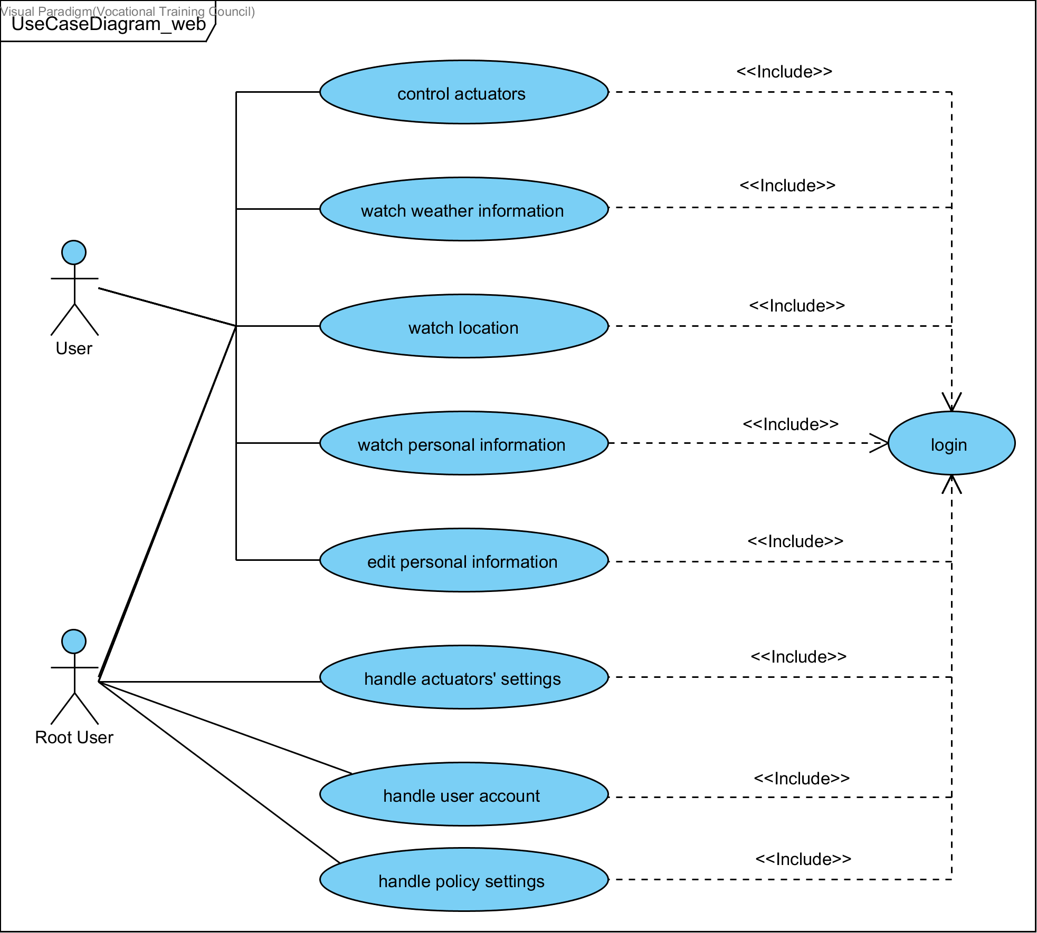
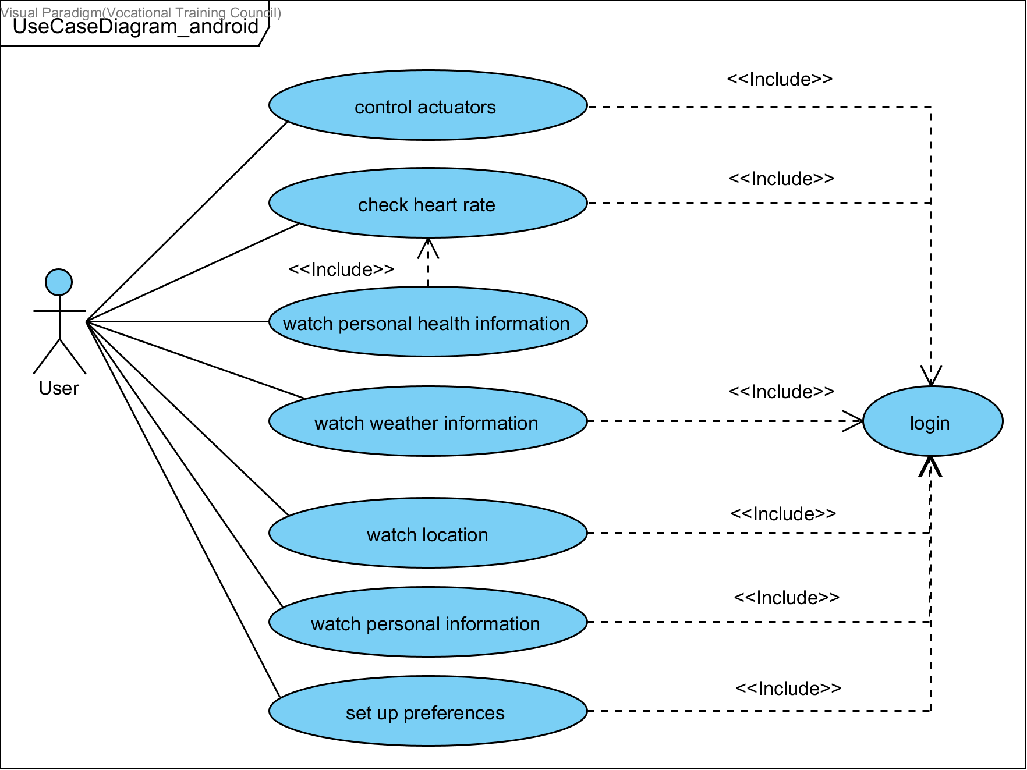
WEBSITE
Use Case Diagram
ANDROID

Slide 38
Other Functions

Slide 39
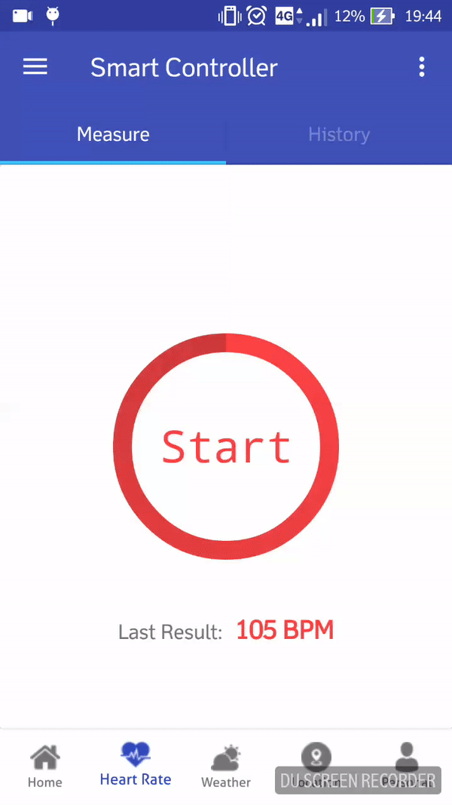
Android Application
Place your screenshot here
HEART RATE

Slide 40
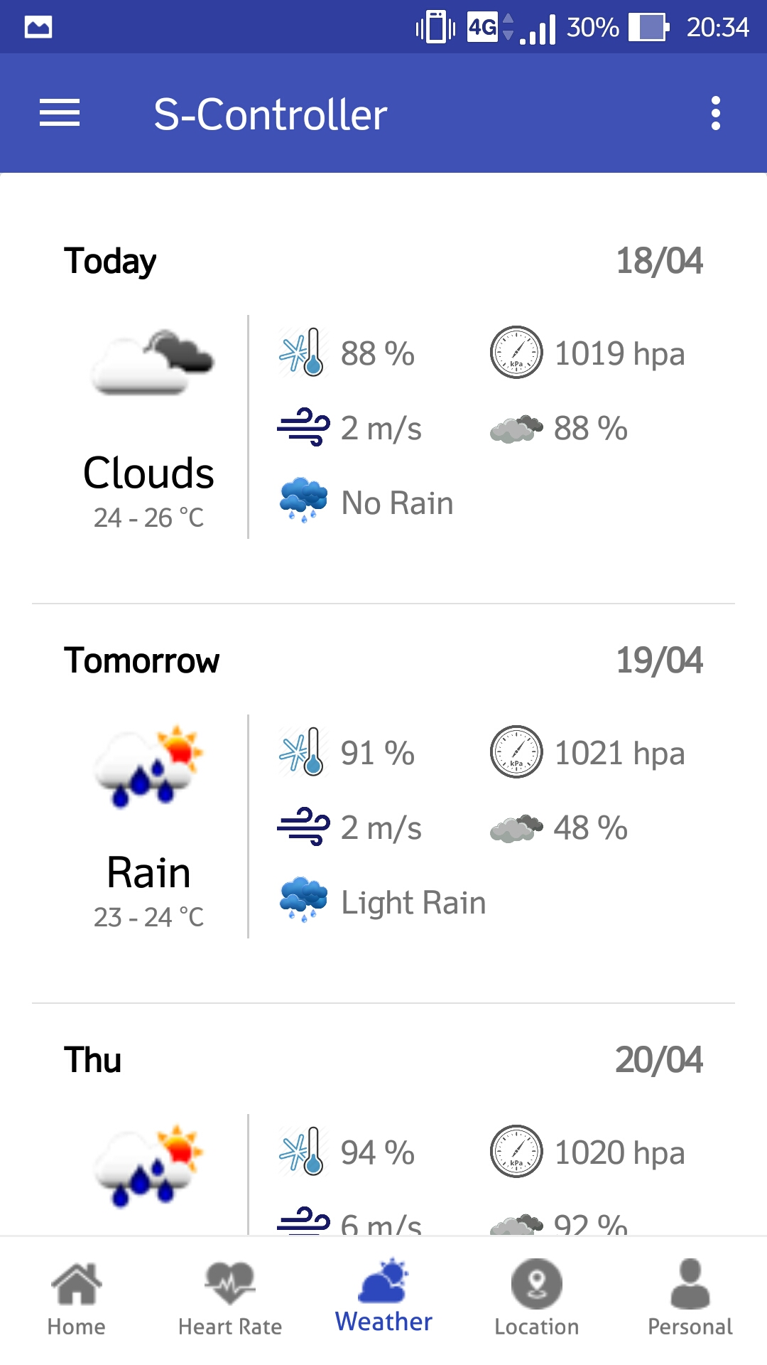
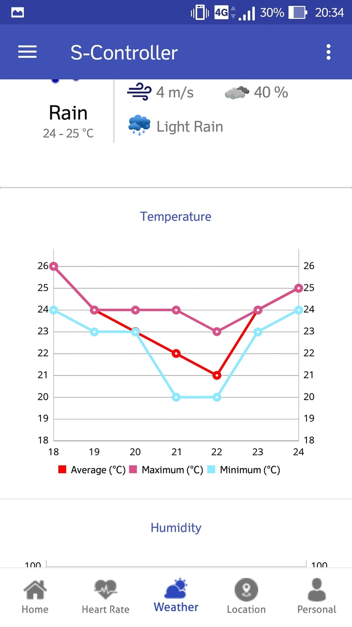
Android Application
WEATHER

Slide 41
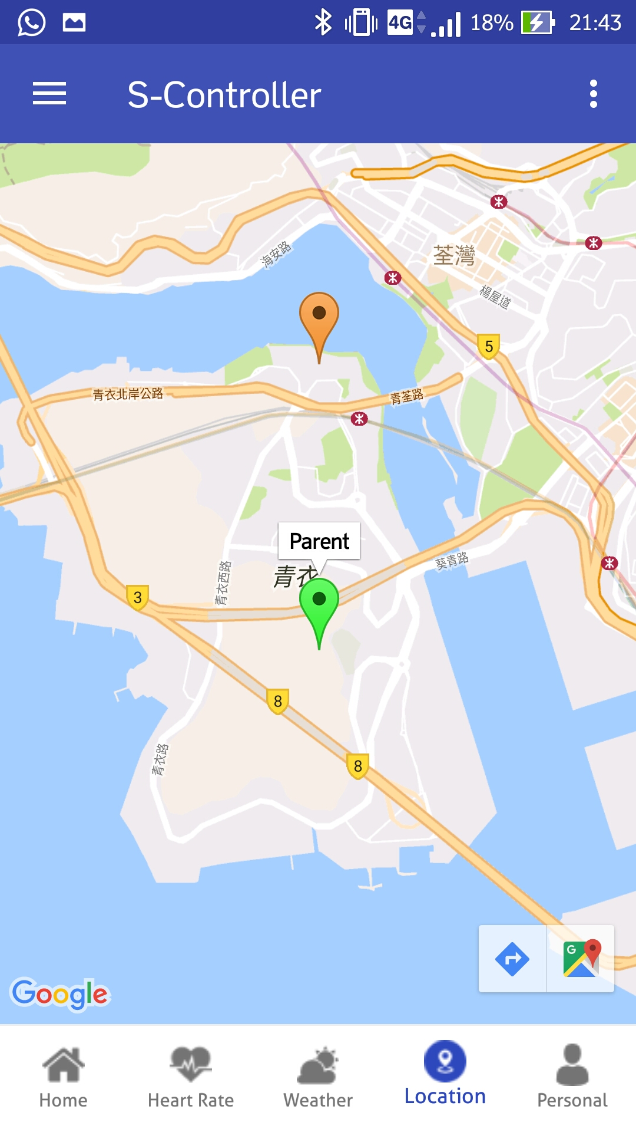
Android Application
Place your screenshot here
LOCATION

Slide 42
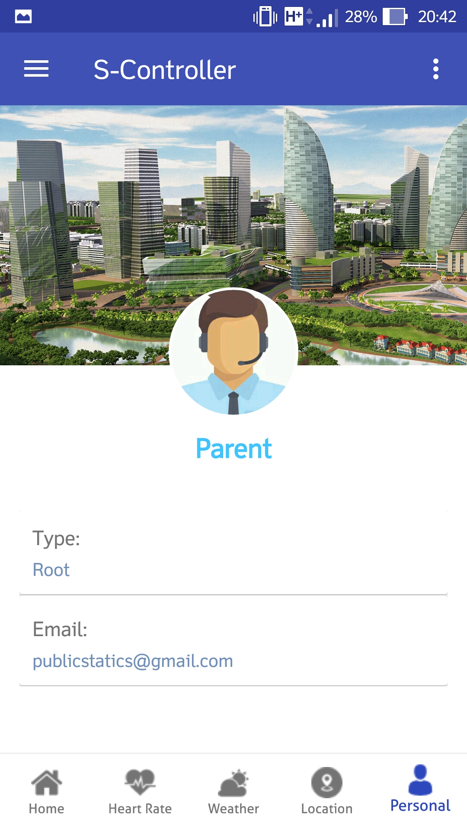
Android Application
Place your screenshot here
PERSONAL

Slide 43
Website
Place your screenshot here
MAIN PAGE

Slide 44
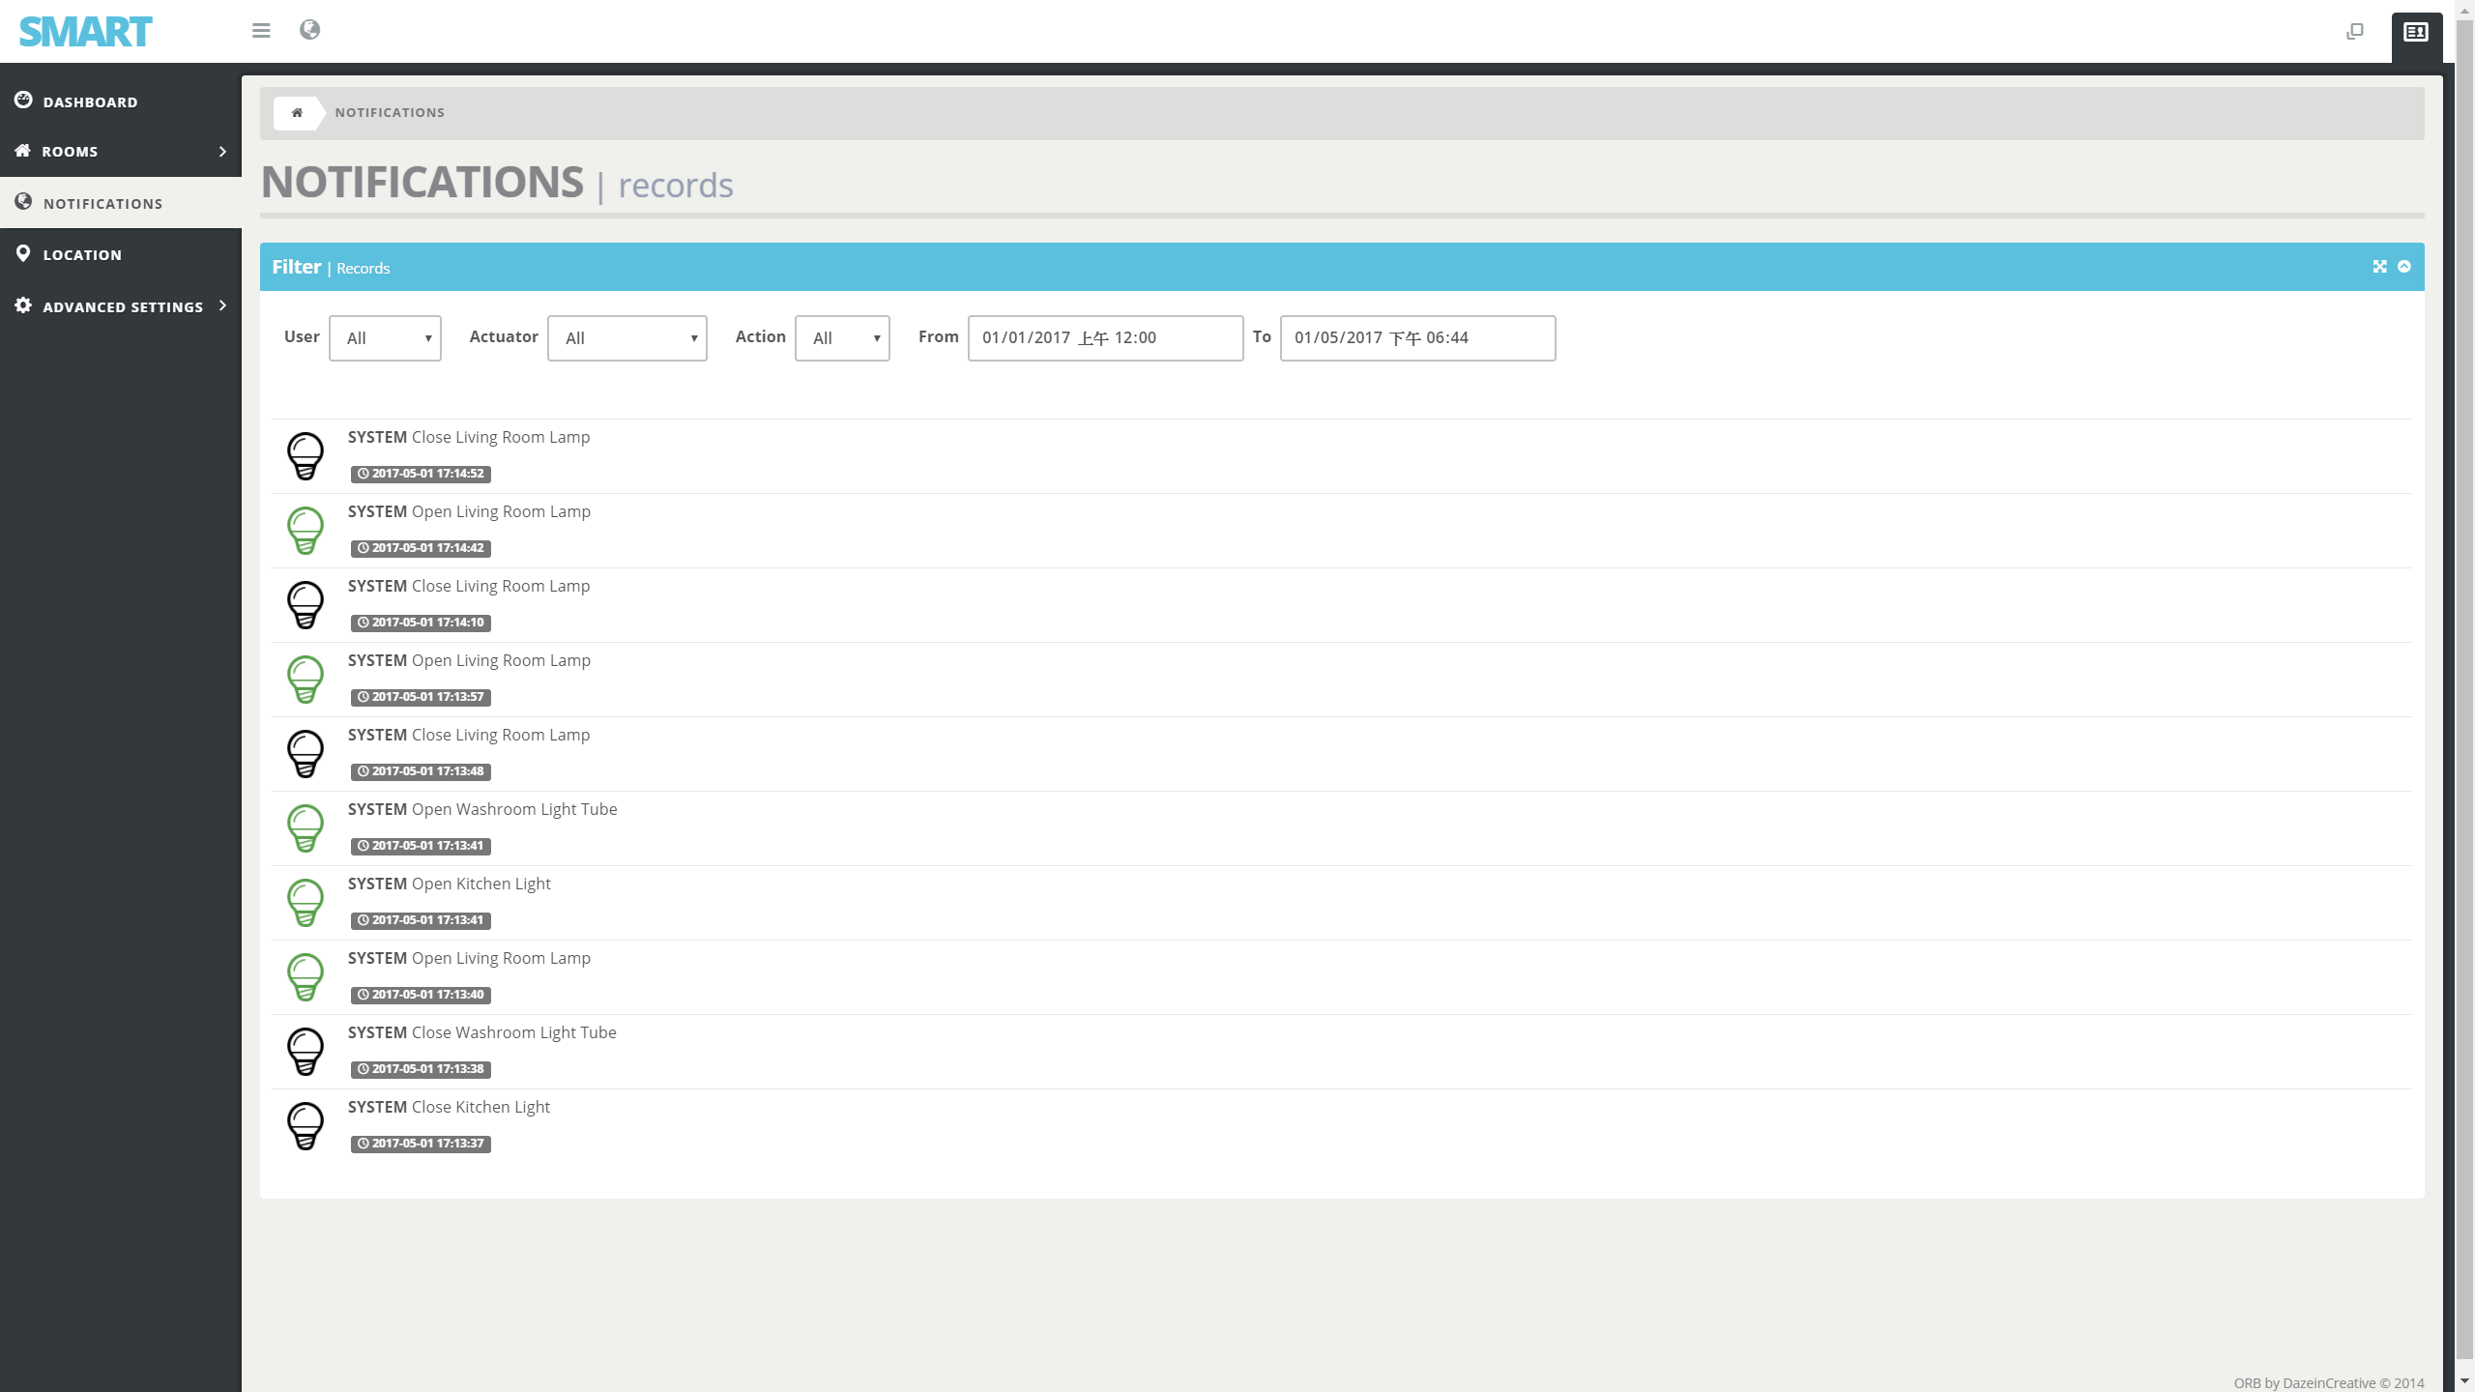
Website
Place your screenshot here
NOTIFICATIONS

Slide 45
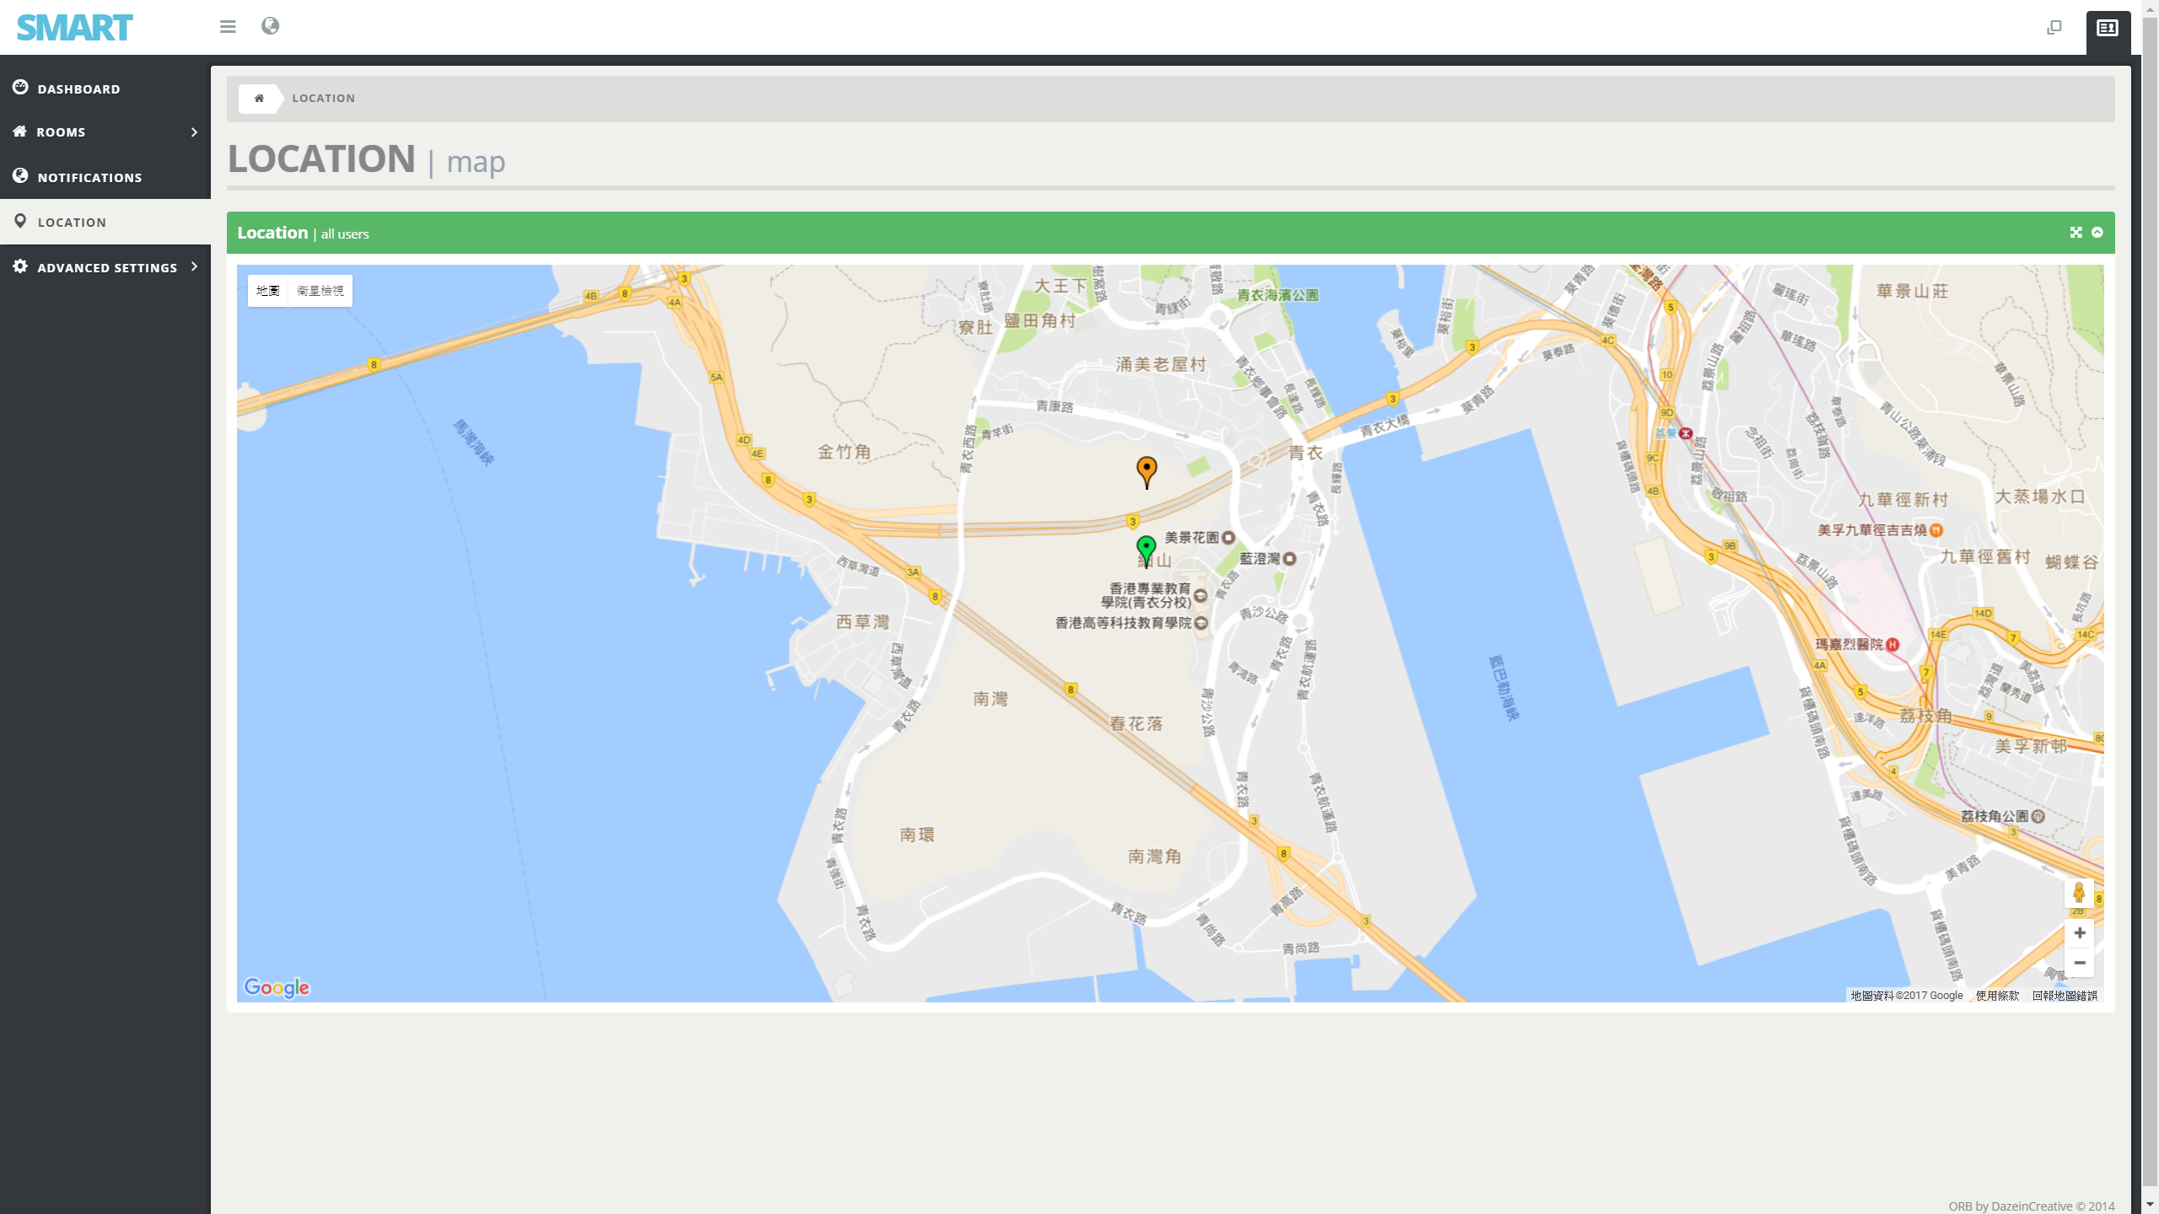
Website
Place your screenshot here
LOCATION

